Slide 1
Deciding Best Keywords from Research Papers for the Marketing of AI Conference
Maxgen Technology Pvt. Ltd,Pune
By : Mrs. Vaishali Nimbalkar ( TL )
Mr.Harshal Patil
Mr. Mayur Rindhe
Mr.Shivshankar Ambhore
Jan , 2020

Slide 2
Business Problem :
A Technological University Arranges AI conference after every couple of years. In this conference university invites all the enthusiast who are interested AI and related technology .Conference is all about recent trends and research happening in Artificial Intelligence field across the globe.
Students from different fields making their contribution to this fields through Writing various Articles and Research papers .University helps students to publish the papers and asure further help.
This year also university wants to conduct AI conference , and university wants that more people should take part in the conference , so they decided to do digital marketing so that they can reach upto more people in less time.
As university is new in the field of Digital Marketing and don’t know about SEO and many more things , so they wants somebody to sort out this problem. University is ready to help and co-operate whatever wants by a technological person.

Slide 3
Data :
Data Required :
For SEO we need keywords (We can decide it manually but that may go wrong).
University has research papers submitted by students , we can get recent topics which are relevant , trending and new in AI.
University has their own database of students & their research papers .
Sourcrs of data :
University database

Slide 4
Methodology :
Collecting the database and convert it into usable format
Importing Excel data to Jupyter(Python)
Missing values treatment and data cleaning(special character removal)
Starting with NLP
Tokenization
Stopwords Removal
Lemmatization
Tdf-idf vecorizor
Applying K-Means Clustering
tSNE
Final keywords (Top 25 )

Slide 5
Terminologies Explained:
Natural Language Processing:
NLP is a branch of data science that consists of systematic processes for analyzing, understanding, and deriving information from the text data in a smart and efficient manner.
Tokenization:
process of converting a text into tokens
Tokens – words or entities present in the text

Slide 6
Stop words :
Any piece of text which is not relevant to the context of the data and the end-output can be specified as the noise.
language stop words (commonly used words of a language – is, am, the, of, in etc.)
Lemmatization:
Lemmatization is an organized & step by step procedure of obtaining the root form of the word, it makes use of vocabulary (dictionary importance of words) and morphological analysis (word structure and grammar relations).

Slide 7
TF-IDF Vecorizor:
Text data can also be quantified directly into numbers using this tf-idf technique.
Term Frequency (TF) – TF for a term “t” is defined as the count of a term “t” in a document “D”
Inverse Document Frequency (IDF) – IDF for a term is defined as logarithm of ratio of total documents available in the corpus and number of documents containing the term T.
K-Means Clustering:
As data available with us is text data and don’t having any labels so we decided to go with unsupervised learning algorithm.
K-means clustering is one of the simplest and popular unsupervised machine learning algorithms.
K represents number of clusters.
A cluster refers to a collection of data points aggregated together because of certain similarities.
We decided the best value of k using Elbow method .

Slide 8
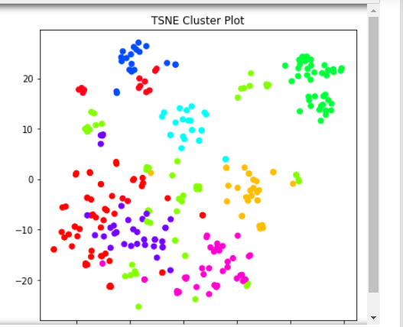
t-SNE(t-Distributed Stochastic Neighbor Embedding):
We have two options for diamentionalty reduction PCA & t-SNE
PCA:Principal Component Analysis or PCA is a linear
feature extraction technique
t-SNE:t-Distributed Stochastic Neighbor Embedding
(t-SNE) is a non-linear technique for dimensionality
reduction that is particularly well suited for the
visualization of high-dimensional datasets.
It is extensively applied in image processing & NLP.

Slide 9
Results : Keywords for SEO
Game Theory
Social Media Analytics
Natural Language Processing(NLP)
Optimization
Computer Vision
Robotics
Model Learning
Neural Networks
Information Security
Linear Programming
Knowledge Graph
Reasoning Based Models
Probability Theory
Recommender System
Bayesian spam filtering
Hidden Markov Model
Decision Making
Reinforcement Learning
Data Mining
Voice Recognition
Web Analytics
Planning & Scheduling
Machine Learning Algorithm
Human Diagnosis
Heuristic Search
Knowledge Representation & Reasoning
Ontology

Slide 10
Discussion :
As we can see from the diagram there are some clusters which are overlapping with each other , it means that there are some text keywords , which are sharing the clusters as they occurred frequently .
We selected 9 clusters as it seems to be the best from elbow method.

Slide 11
Conclusion :
Hence with the help of power of NLP and t-SNE we can suggest that 25 keywords can be used for digital marketing (SEO)
As these keywords we suggested from research papers , so there is also need to use some extra keywords which are not covered in this keywords , so as to do better SEO and get better traffic on website .

Slide 12


